Slide 1
Data Structures and Algorithms CS2002
Priority Queues, Heaps, Heapsort

Slide 2
Heaps
(ref 5.6 Data Structures in C++)
The heap abstract data type
  Definition: A max(min) tree is a tree in which the key value in each node is no smaller (larger) than the key values in its children. A max (min) heap is a complete binary tree that is also a max (min) tree
  Basic Operations:
    creation of an empty heap
    insertion of a new element into a heap
    deletion of the largest element from the heap

Slide 3
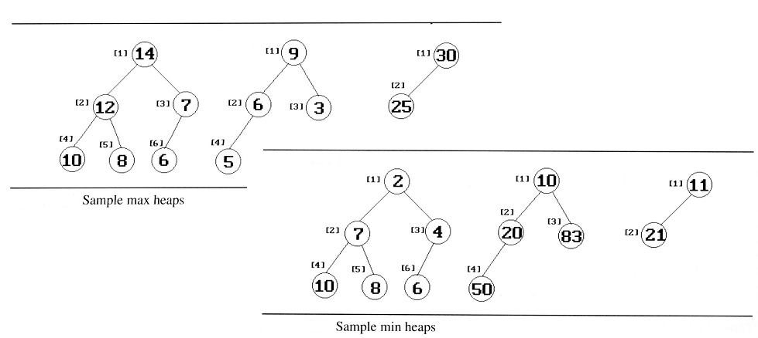
Heaps
The examples of max heaps and min heaps
  Property: The root of max heap (min heap) contains the largest (smallest) element

Slide 4
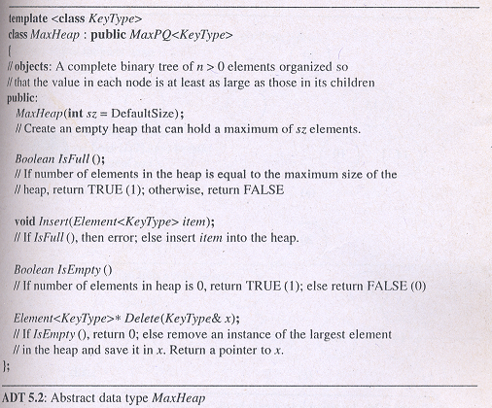
Heaps
Abstract DataType of MaxHeap

Slide 5
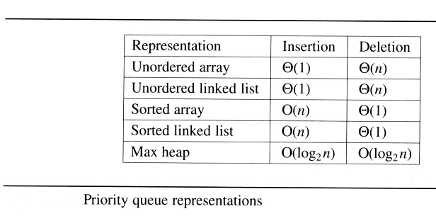
Heaps
Queue in Chapter 3: FIFO
Priority queues
  Heaps are frequently used to implement priority queues
  delete the element with highest (lowest) priority
  insert the element with arbitrary priority
machine service:
amount of time
(min heap)
amount of payment
(max heap)

Slide 6
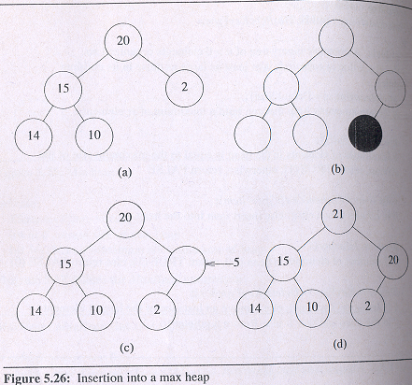
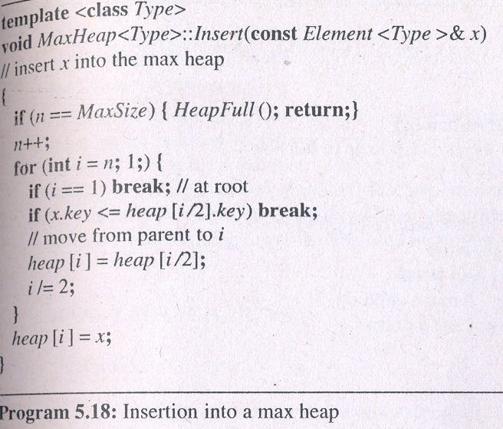
Heaps
Insertion Into A Max Heap
  Analysis of insert_max_heap
    The complexity of the insertion function is O(log₂ n)

Slide 7
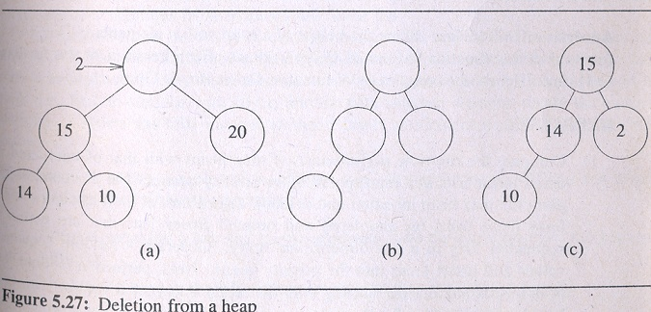
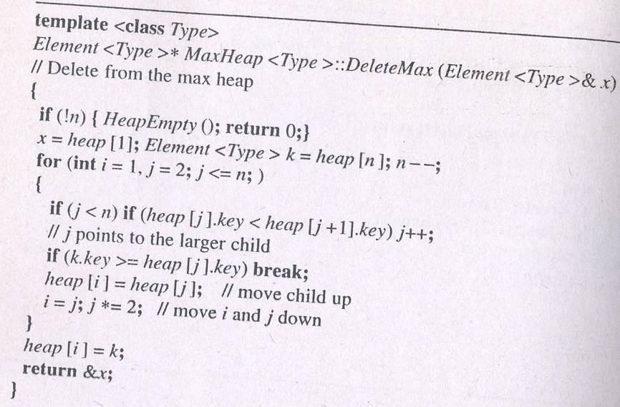
Heaps
Deletion from A Max Heap
  Analysis of delete_max_heap
    The complexity of the deletion function is O(log₂ n)

Slide 8
Homework
Write an algorithm to insert into a min heap. The complexity of your algorithm should be O(logn).
Write an algorithm to delete the smallest item from a min heap. The complexity of your algorithm should be O(logn).

